Slide 1
FULL STACK WEB DEVELOPMENT -2 SEM-VTH
Topic :- Node.js & its core features : Asynchronous , Single threaded & Event- driven
Name:- Anshika Gangwar (22105020)
University Roll No. :- 22033105002
Course :- B.voc (Web Designing)
Submitted to :- Mr. Kulanshu Sharma

Slide 2
Table of Content
Node.js
Architecture of node.js
Core features of node.js
Asynchronous & Non – Blocking I/O
Single - Threaded
Event – Driven Architecture
Event Loop
Thread Pool
Combining of features
Bibliography

Slide 3
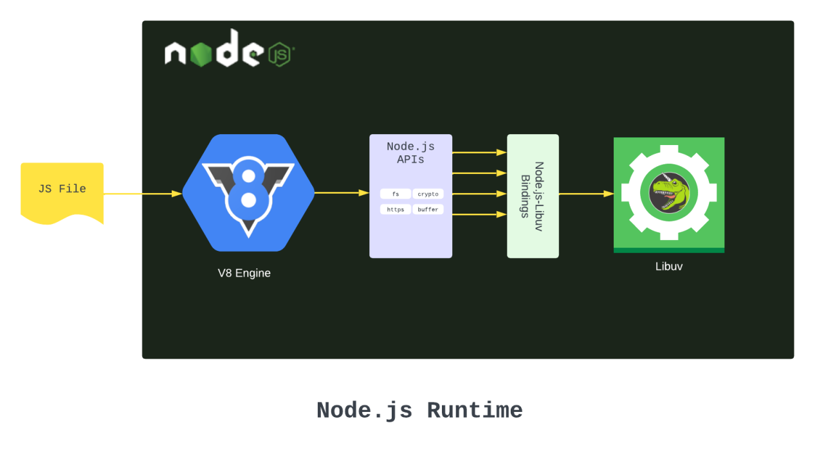

Node.js
Definition:-
Node.js is a runtime environment that allows JavaScript to run on the server-side.
Key Features:
Built on Chrome's V8 Engine
Cross-Platform Compatibility
Non-blocking I/O

Slide 4
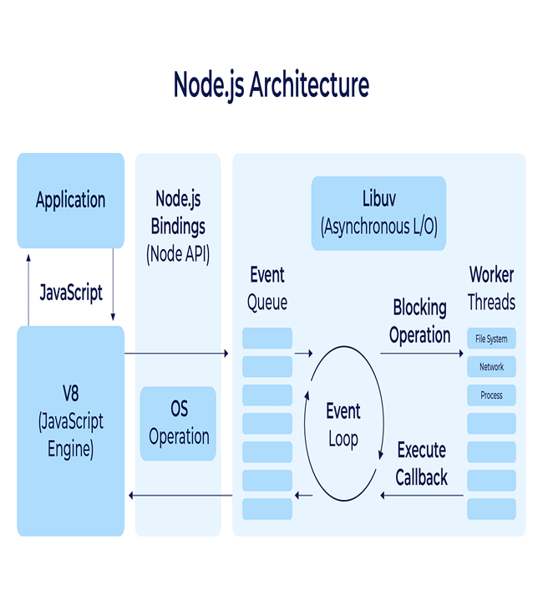
Architecture of Node.js
Node.js architecture is single-threaded, asynchronous, and event-driven. It uses a single thread to handle multiple requests concurrently, relying on an event loop to manage incoming tasks. Non-blocking I/O operations are handled using the libuv library, which offloads heavy tasks to a thread pool. The V8 engine executes JavaScript code efficiently. This architecture allows Node.js to handle many simultaneous connections with minimal overhead, making it ideal for real-time applications and APIs.

Slide 5
Core features of Node.js
Asynchronous
I/O
Single threaded
Event – driven
Architecture
Node.js performs non-blocking I/O operations, allowing tasks to run in the background without waiting for completion.
Node.js uses a single thread to handle multiple client requests efficiently via the event loop.
Node.js operates on an event-driven model where actions are triggered by events and handled via callbacks.

Slide 6
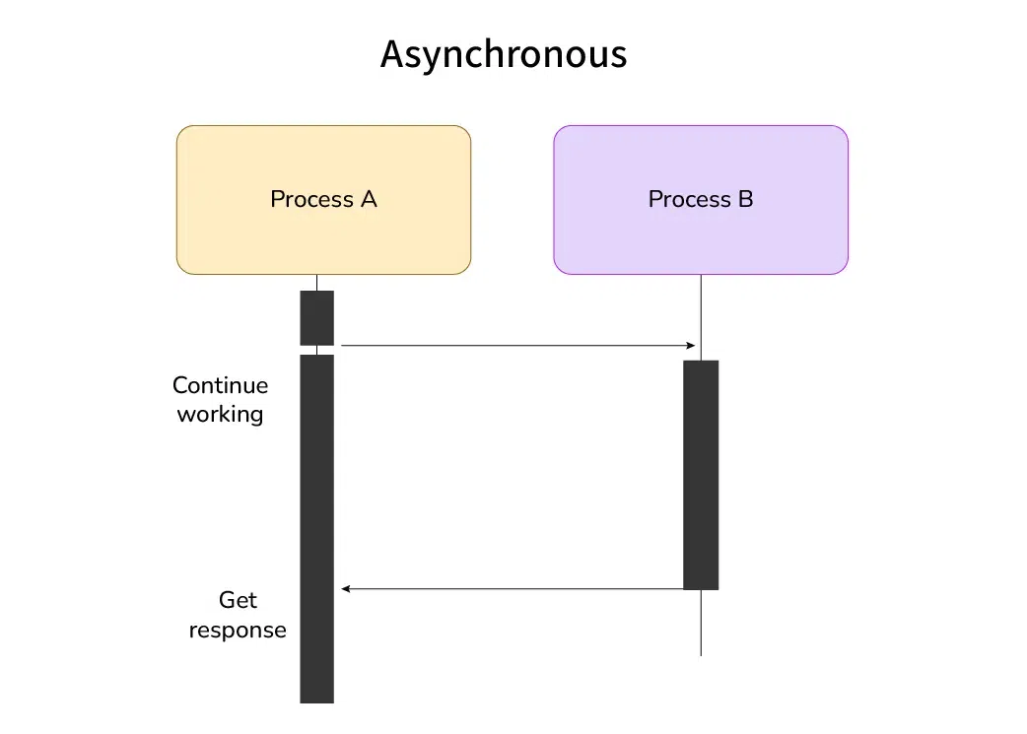
Asynchronous & Non-Blocking I/O
Non-Blocking I/O: When a request is made to a Node.js server, it doesn’t block the execution until the response is ready. Instead, Node.js moves on to the next request. Once the response is ready, it calls a callback function, allowing other processes to continue in the meantime.
Asynchronous: Node.js supports asynchronous operations, meaning it can perform multiple operations in the background (like reading a file or accessing a database) without waiting for each task to finish before starting the next.

Slide 7
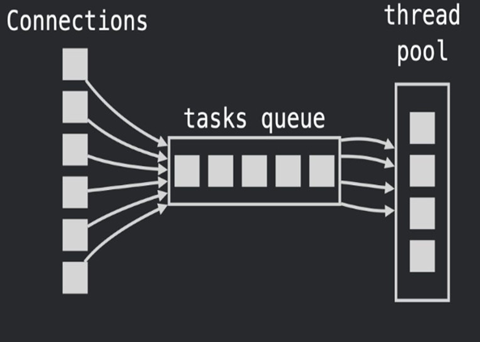
Single - Threaded
Despite handling many operations concurrently, Node.js runs on a single thread using an event loop. It doesn’t spawn new threads for each request, which avoids the overhead of thread creation and management seen in traditional multi-threaded environments.
The single thread is based on the event loop, which manages the asynchronous calls. This architecture enables it to handle thousands of concurrent connections with very minimal cost to memory and CPU usage.

Slide 8
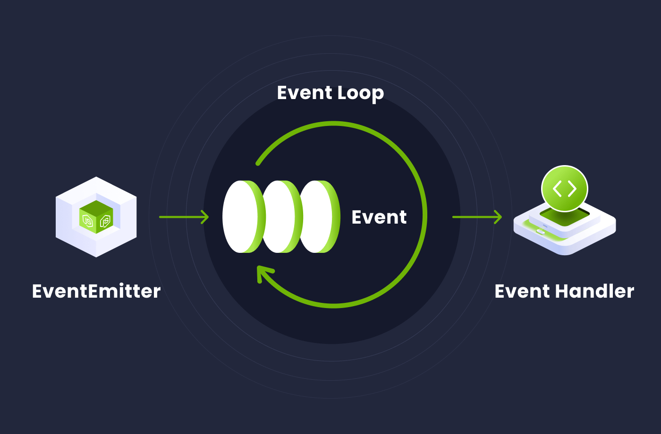
Event – Driven Architecture
Node.js applications are event-driven. This means that much of the work is done by listening to events (e.g., an HTTP request is received, or a file is ready to be read), and then executing callbacks when those events are triggered.
The event loop constantly checks for events that have occurred (such as data arriving from the network or I/O completing) and then dispatches them to the appropriate callbacks.

Slide 9
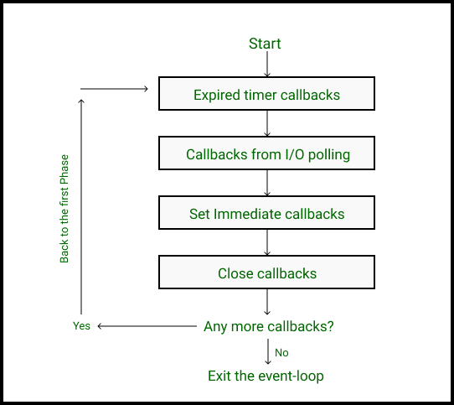
Event loop
The event loop is the core of Node.js’s asynchronous architecture. It allows Node.js to handle multiple tasks (I/O operations, HTTP requests, etc.) with a single thread.
It continuously checks for pending events (like completed I/O operations or timers) and executes corresponding callbacks.
Tasks like network requests, file system reads/writes, and database queries are initiated asynchronously, and the event loop waits for them to complete before triggering the callback.

Slide 10
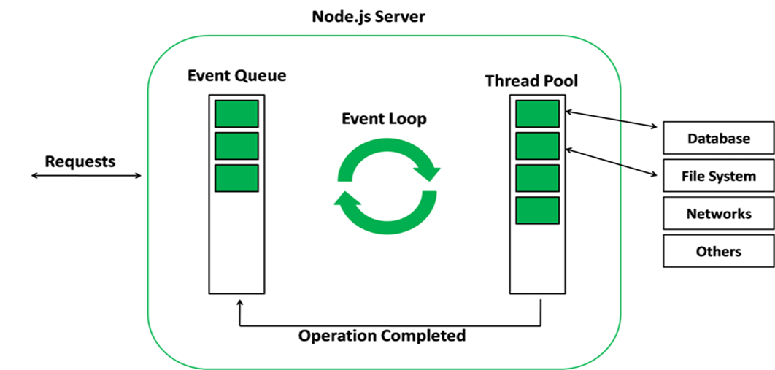
Thread Pool
Node.js uses a thread pool (provided by libuv) for handling blocking tasks that cannot be performed by the event loop itself. These tasks include:
File system operations (like reading or writing files).
DNS lookups.
Compression (e.g., zlib).
Some cryptography operations.
While the main event loop is single-threaded, the thread pool contains multiple threads (typically 4 by default) to handle blocking operations asynchronously. This ensures the main event loop remains non-blocking and responsive.

Slide 11
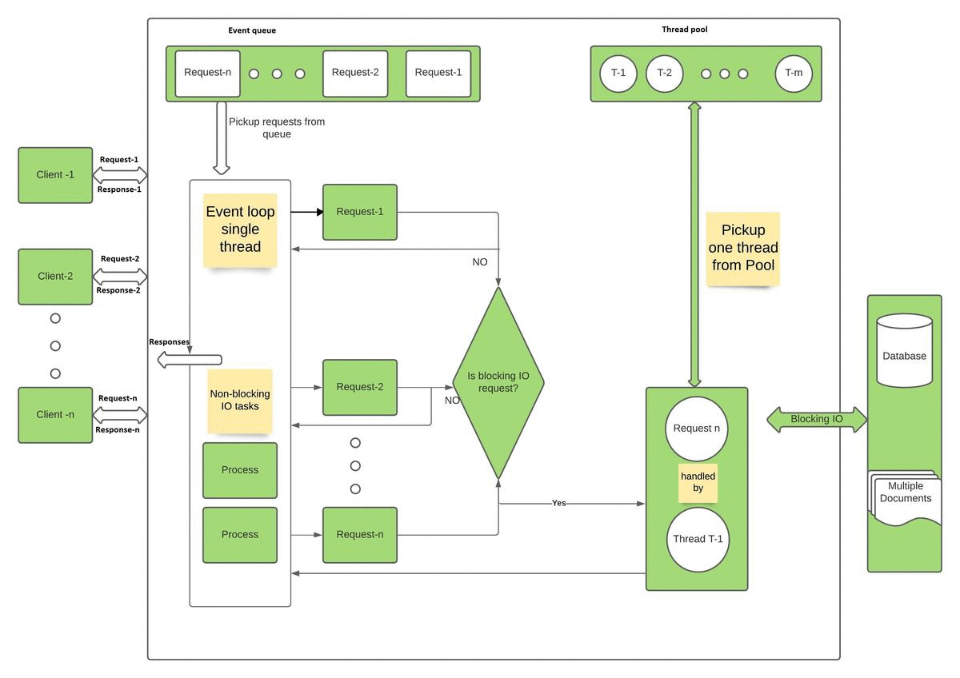
Combining the Features
Node.js works as asynchronous, single-threaded, and event-driven simultaneously by combining unique architectural features. Although it uses a single thread for JavaScript execution, it achieves concurrency through asynchronous, non-blocking I/O. Tasks like file reading or database queries are delegated to the system, allowing the main thread to continue processing without being blocked. Node.js operates on an event-driven model where the event loop listens for events like completed I/O operations. Once an event occurs, the corresponding callback is triggered. This non-blocking approach lets Node.js handle multiple tasks simultaneously. As a result, Node.js can manage thousands of concurrent connections efficiently with one thread, making it ideal for scalable, real-time applications.

Slide 12
Bibliography
https://nodejs.org/en/learn/asynchronous-work/event-loop-timers-and-nexttick
https://www.geeksforgeeks.org/explain-the-event-driven-architecture-of-node-js/
https://medium.com/capital-one-tech/node-js-control-flow-an-overview-68f76ef750c3
https://www.geeksforgeeks.org/how-the-single-threaded-non-blocking-io-model-works-in-nodejs/
https://nodejs.org/docs/latest/api/
https://www.scaler.com/topics/nodejs/what-is-node-js/

Slide 13
Thank You

